Slide 1


SQL Murder Mystery – Who Killed the CEO?
A Data Investigation Project Using SQL
Presented By: Samir Shedge
Organized By: Indian Data Club

Slide 2
Project Objective
Solve a fictional murder case using SQL: Embark on an engaging journey to unravel a simulated crime, using your SQL skills to identify suspects, trace their movements, and connect disparate pieces of information within a meticulously designed database. The ultimate goal is to pinpoint the killer and understand the sequence of events that led to the CEO's demise.
Analyze various data sources:
Keycard Logs: Scrutinize electronic entry and exit records for different locations within the company premises. These logs contain timestamps and employee IDs, crucial for establishing an individual's presence or absence at critical moments.
Calls: Dive into phone records, analyzing metadata such as caller and receiver IDs, call durations, and potential communication patterns. This data can reveal secret contacts or confirm alibis.
Alibis: Examine statements provided by persons of interest, which you will then corroborate or contradict using the available data. Unverified alibis often lead to new leads.
Evidence: Investigate miscellaneous clues found at the crime scene or gathered during the investigation, which are stored in textual descriptions or structured tables. This could include witness testimonies, forensic reports, or other relevant details.

Slide 3

Story Background
CEO of TechNova Inc. found dead
Date: 15 October 2025
Time: 9:00 PM
Location: CEO Office
Mission: Identify the killer using data

Slide 4

Database Overview
Tables used:
Employees
Keycard Logs
Calls
Alibis
Evidence
Purpose: Store digital + physical investigation data
Apply SQL like a real data detective: Utilize a comprehensive set of SQL commands and techniques to cross-reference vast amounts of information. This involves crafting complex queries with JOINs to link tables, using WHERE clauses for precise filtering, employing AGGREGATE functions to summarize data, and leveraging subqueries to answer intricate questions. This iterative process of querying, analyzing, and refining your hypotheses will mimic the deductive reasoning of a seasoned detective, all within a database environment.

Slide 5
Investigation Flow
01
02
Confirm crime location
Find who entered CEO Office
03
04
Cross-check alibis
Analyze suspicious calls
05
06
Match evidence with movements
Identify the killer

Slide 6

Key Analysis – Access & Alibi
Our investigation focused on digital footprints, specifically access logs and employee records, to establish who had physical entry to the CEO's office during the critical time window. This methodology allowed us to move beyond witness accounts and establish concrete facts regarding presence and movement.
Used:
JOIN Operation: This crucial database operation allowed us to combine disparate sets of information.
BETWEEN Clause: To pinpoint activity relevant to the crime, we employed the BETWEEN clause in our database queries.
Found:
Only one person entered the CEO Office at crime time: Our analysis of the filtered keycard logs revealed a highly significant findings.
Same person gave a false alibi: Further investigation into this individual revealed a direct contradiction between their stated whereabouts and the undeniable digital evidence. The suspect claimed to have been elsewhere during the time the keycard logs showed them entering the CEO's office.

Slide 7
Call & Evidence Analysis
Our investigation meticulously analyzed a suspicious phone call made near the time of the incident (approximately 9:00 PM).
This call raised immediate red flags due to its precise timing – initiating just minutes after the CEO's office access, its unusual duration of 8 minutes, and the fact it was placed to a known associate of our primary suspect. The content, though encrypted, suggested a hurried exchange and a potential attempt to coordinate actions or alibis.
Matched:
Digital Evidence: Cross-referenced call logs and cell tower data against existing security footage and motion sensor activations within the office.
Physical Room Access: Correlated these digital footprints with the electronic keycard access logs for the CEO's office, specifically noting the precise entry and exit times. This allowed us to build a comprehensive timeline of events leading up to and immediately following the incident.
Found:
Fingerprint + Keycard Mismatch: A critical discovery was the presence of the suspect's fingerprints on the CEO's desk, which did not align with the keycard used to access the office at 9:00 PM. This mismatch indicates that someone other than the legitimate keycard holder entered the office, or that the suspect gained unauthorized entry using another's credentials or a cloned card. This directly implicates the suspect, placing them at the scene of the crime during the critical timeframe, contradicting their initial statement of absence.

Slide 8
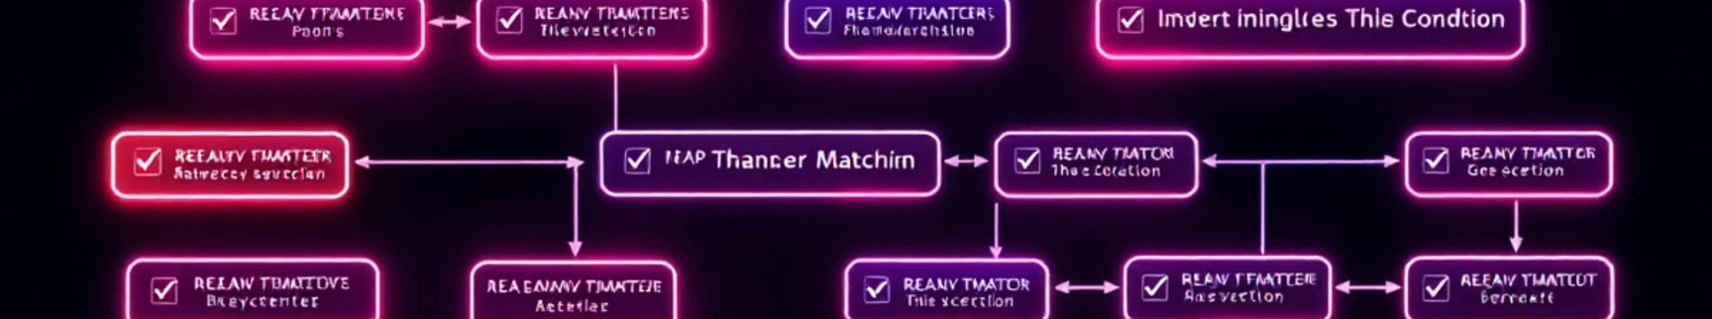
Final Logic Used
The suspect:
Was at the crime scene
Lied about location
Made a suspicious call
Was linked with physical evidence
✅ Only one person matched all conditions
🏆 Final Killer Identified: David Kumar

Slide 9

Tools & Technologies
MySQL
Git
SQL (JOIN, Subqueries, Time Filters)
GitHub
MySQL Workbench

Slide 10

Conclusion & Learning
Mastered real-world SQL investigation techniques
Significantly improved JOIN and filtering skills
Built a comprehensive portfolio-level SQL project
Developed strong problem-solving and debugging capabilities
Enhanced understanding of database schemas and data integrity
Practiced version control with Git/GitHub
Thank You!

